Slide 1
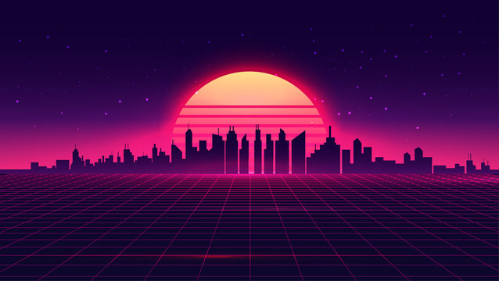
Catch Maker
Richie, Davis

Slide 2
Elevator pitch
This Catch game captures the good old feeling of catch that we all know and love.
But this time, you can have your own spin and feeling to it while you clear or create levels and play against your friends,
with your very own skins and sounds you can create and change that creates huge longevity.

Slide 3
World Background
The main world background exists with our newly improved engine.
Base game has a retro style with shapes (circles, squares, triangles, etc) with neon lights.
You can also create and change your own catch game.

Slide 4
Pillars
Core concepts and themes of our game include the original retro style with neon lights, shapes, and funky retro music.
Base Catch Game(50%), Skin Creator(20%), Multiplayer(10%) , Level Creator(20%)

Slide 5



Gameplay
the player controls a character holding a bowl .you catch shapes falling from top to bottom.
You move by pressing buttons to move and dash around the screen.
The default keybinds are left/right arrows to move and shift to dash.

Slide 6

Features
Able to switch skin in built in skin maker. Design own falling shapes and catcher.
Shapes with a red outline, are special shapes that will appear to help you catch the next shape when dashing is considered
impossible to catch it in a strict timespan allocated. Collecting a outlined shape will make the catcher's dash fast enough
to catch the next shape.

Slide 7
Market Analysis
Compared to Fruit Ninja. And other catching games.
Aims to make money is with a small price of 4.99$

